Slide 1
Stock Dashboard
Data Wonders Group
Project #3
Amit Sharma
Javon Seaforth
Kyle Eaton

Slide 2
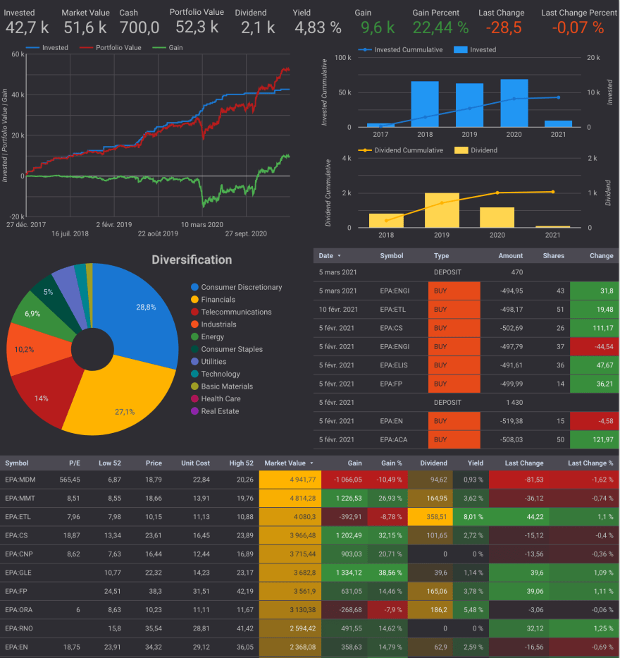
Overview
Introduction
Dataset
Tools/Process
Visualization
Conclusions
Potential Future Efforts

Slide 3







Introduction
COVID-19
$ impact
S&P 500 market

Slide 4
Dataset
Started with ~8000 rows of daily closing price and volume data to create SQlite3 database
Queried and extracted average stock price and volume data over 5 years (2018 – 2023)
Used above data to create url for data visualization

Slide 5






Tools/Process
Jupyter Notebooks -> SQLite DB
SQLite DB -> Python
Python -> jQuery
jQuery/Ajax/Flask -> HTML

Slide 6
Visualization
On to the HTML dashboard!
Stock Dashboard

Slide 7
Conclusions
ETL completed successfully
Interactive URL -> successful dynamic data exchange platform
significant post covid-19 recovery and growth for hotel stocks
Franchise business model Good free cash flow, low debt/EBIT ratio (2.5-3) = Good investment
Airlines and cruise-line not performing that well
Asset ownership model Poor free cash flow, high debt/EBIT ratio (>6) = Poor investment

Slide 8
Potential Future Efforts
Predictive Modeling of which stocks/portfolio mixture in which to invest.
Sentiment analysis – investor perception towards certain stocks based on latest news headlines.

